Slide 1
Sprint 4 Delivery
Group 1 - Alex, Angel, Atanas, Stoyan, Tsanko
Notes:
Goal of the sprint:
Improve performance
look into a time series database
work on summary tables and events for inserting
finish alerting.
All are on 90%

Slide 2
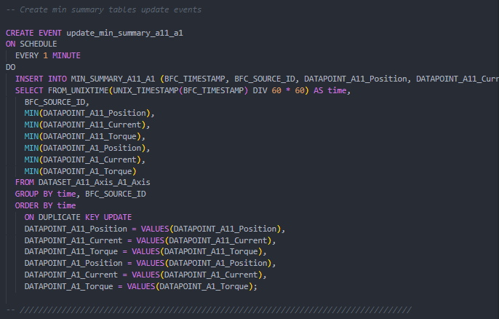
Summary Tables and Automatic Updating

Slide 3


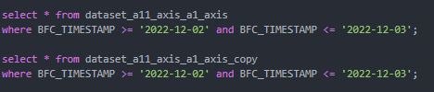
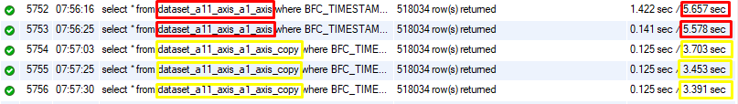
Database Partitioning (Sharding)
FOREIGN KEYS

Slide 4
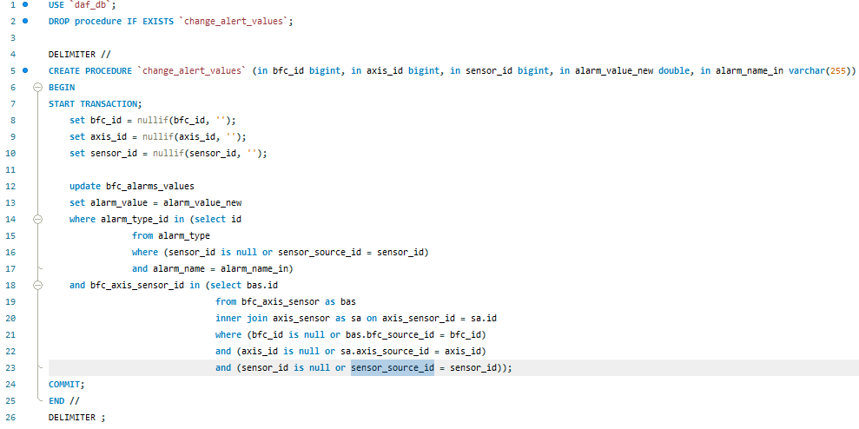
Database expansion

Slide 5
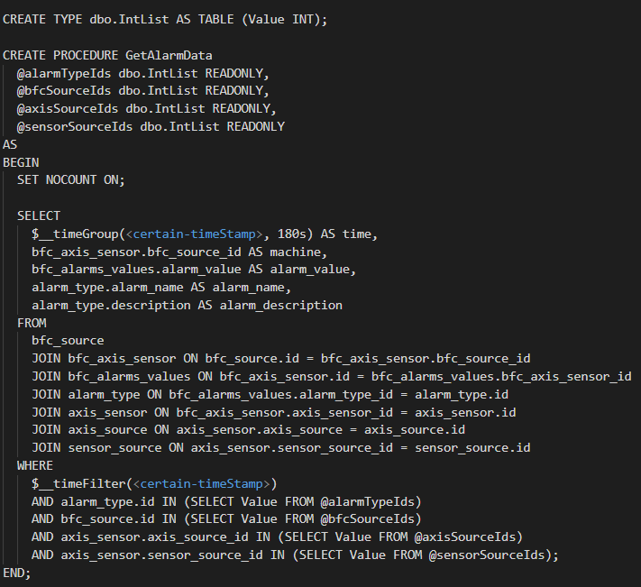
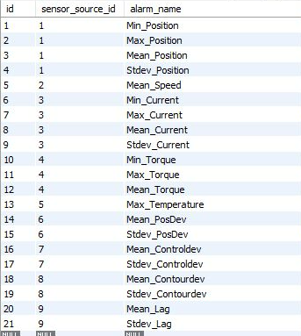
Alarm Query

Slide 6

What’s next?
Notes:
Finish tasks this week and hand over deliverables
Alert selection queries

Slide 7
Thank you for your time

